Slide 1
Find out about… LIVES OF THE FIRST WORLD WAR
Delivered in partnership with D C Thompson Family History

Slide 2
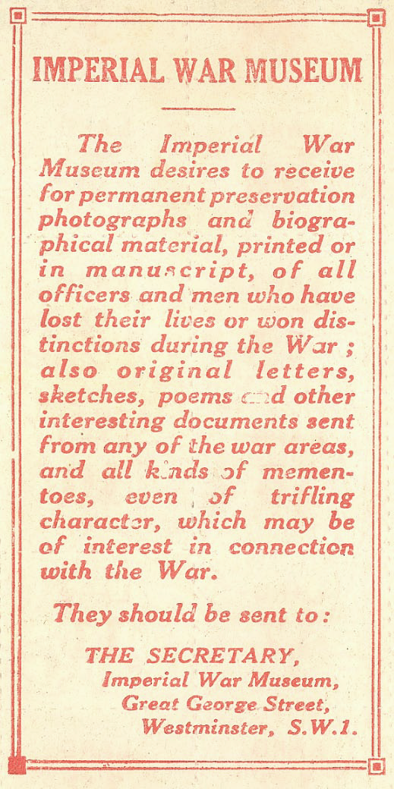
In 1917, many millions of people were involved in what we now call the First World War. At this time the newly formed Imperial War Museum asked the British public to help it to tell the story of the war.

Slide 3
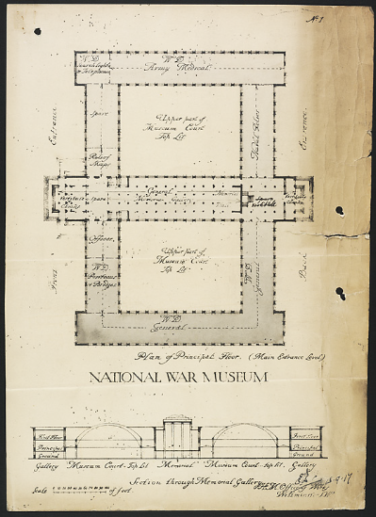
The museum was not created to celebrate war, but to remember the ‘toil and sacrifice’ of millions of people.

Slide 4
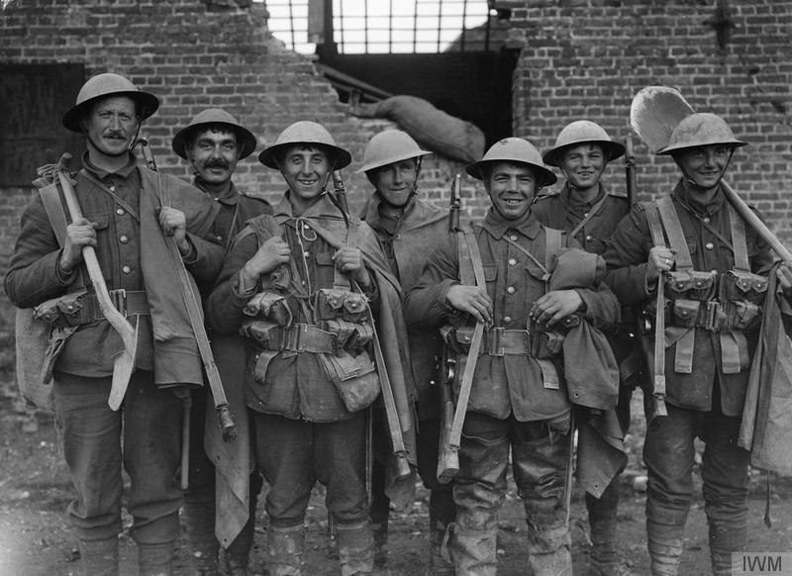
It was intended to be so complete…
© IWM (Q 649)
Notes:
Photograph description
A party of British troops with guns and shovels at Fleurbaix.

Slide 5
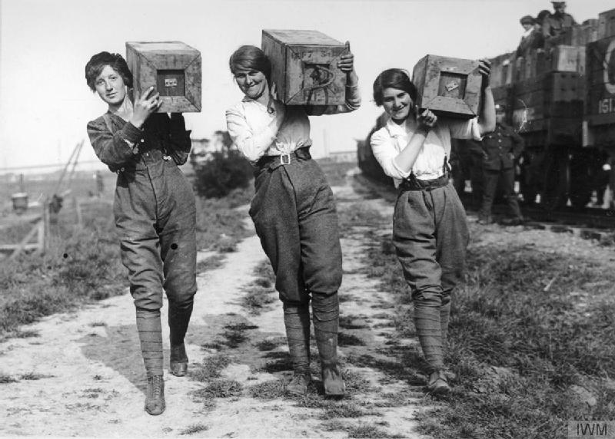
that every man or woman…
© IWM (HU 90283)
Notes:
Photograph description
Women carrying salvaged shell boxes.

Slide 6
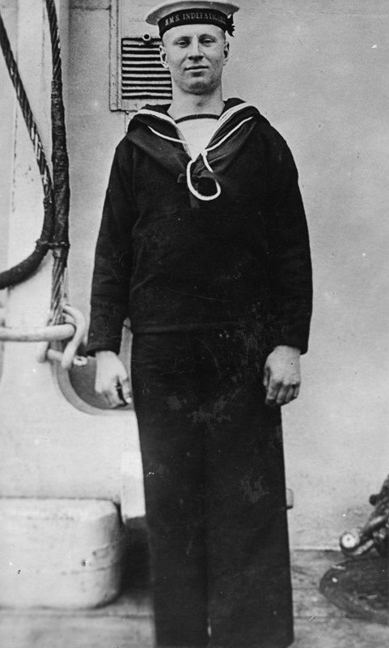
soldier, sailor, airman or civilian…
© IWM (HU 123633)
Notes:
Photograph description
Stoker 1st Class Robert Francis Kitt K/25413.
https://livesofthefirstworldwar.org/lifestory/6401526
Unit: Royal Navy, HMS Indefatigable. Death: 31 May 1916 at Battle of Jutland. Son of Thomas and Lucretia Kitt, of Notter Cottage, Hatt, Cornwall.

Slide 7
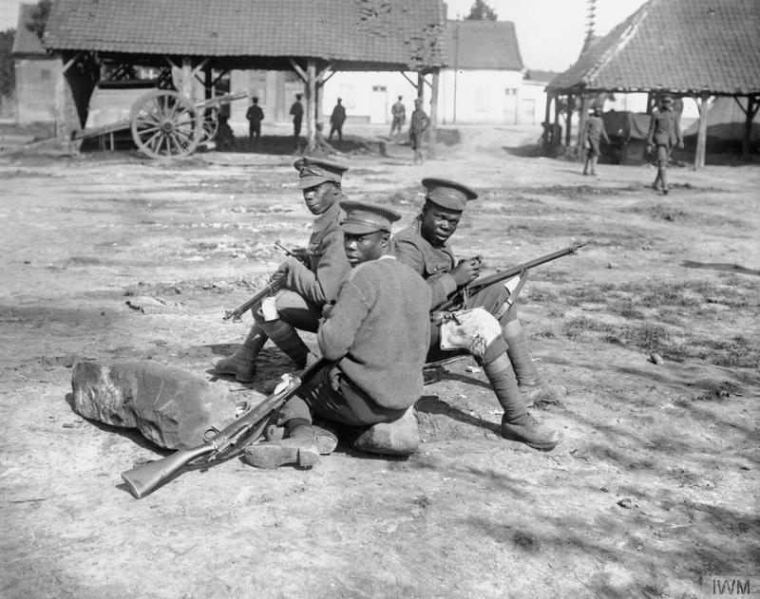
from across Britain and the Commonwealth…
© IWM (Q 1201)
Notes:
Photograph Description
Troops of the West Indies Regiment cleaning their rifles on the Albert - Amiens road, September 1916.

Slide 8
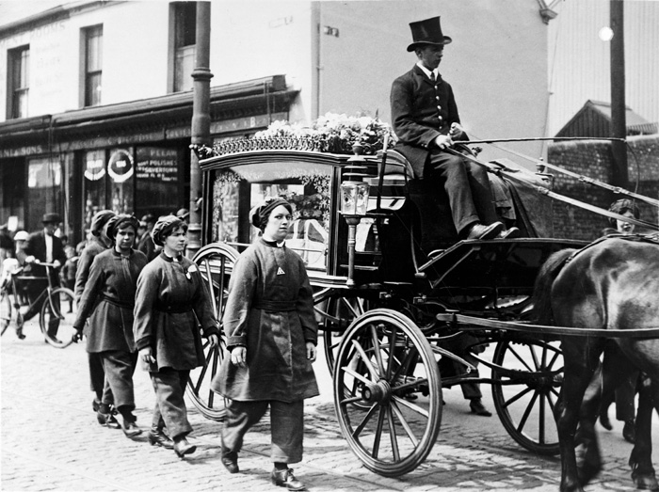
would find a record of their contribution.
© IWM (Q 108454)
Notes:
Photograph description
Female munitions workers walk beside the horse-drawn hearse of one of their colleagues, killed at work. They are wearing their factory uniforms as a sign of respect during the funeral procession through Swansea.

Slide 9
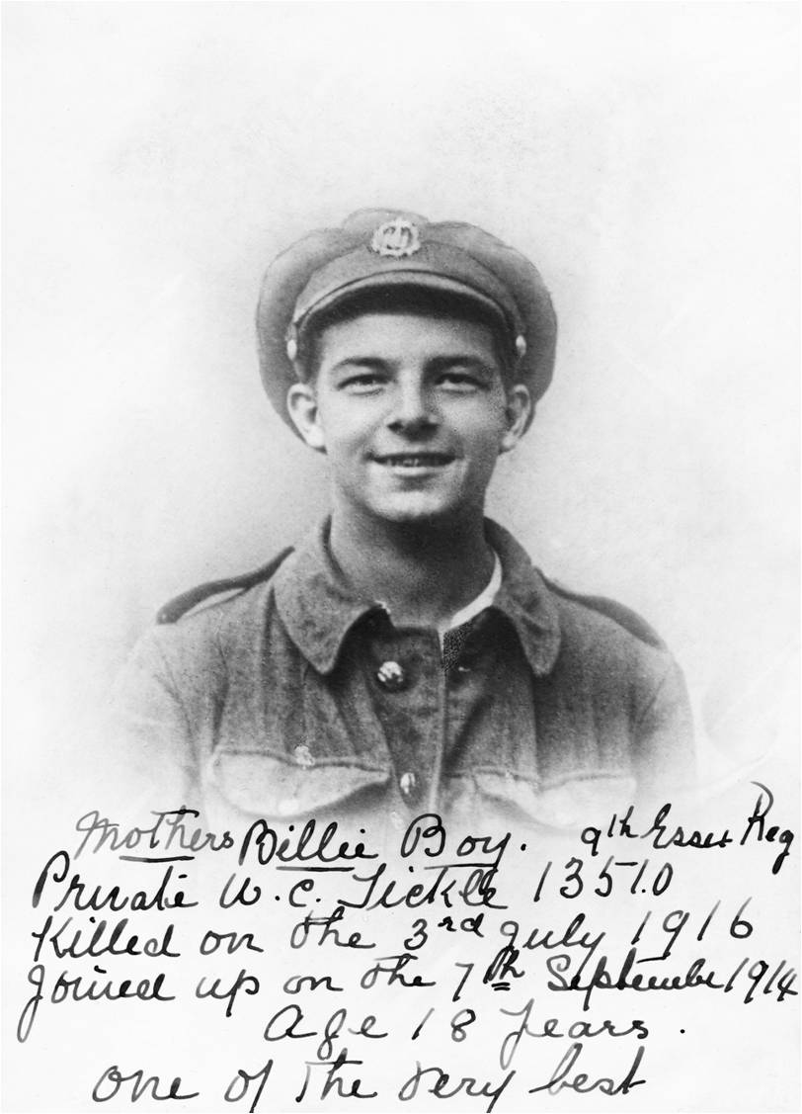
But the scale of the conflict meant that not every story could be told in a single building.
© IWM (HU 096725)
Notes:
Photograph description
Pte Tickle enlisted on 7 September 1914 and was accepted although he was under age. He was killed on 3 July 1916, aged 17, during the Battle of the Somme. His mother's handwritten note on the photograph (taken on 22 June 1916, a few days before his death) describes him as "One of the very best". Pte Tickle is commemorated on the Thiepval Memorial. Photograph presented by his mother, Mrs E A Tickle of Hornsea.

Slide 10
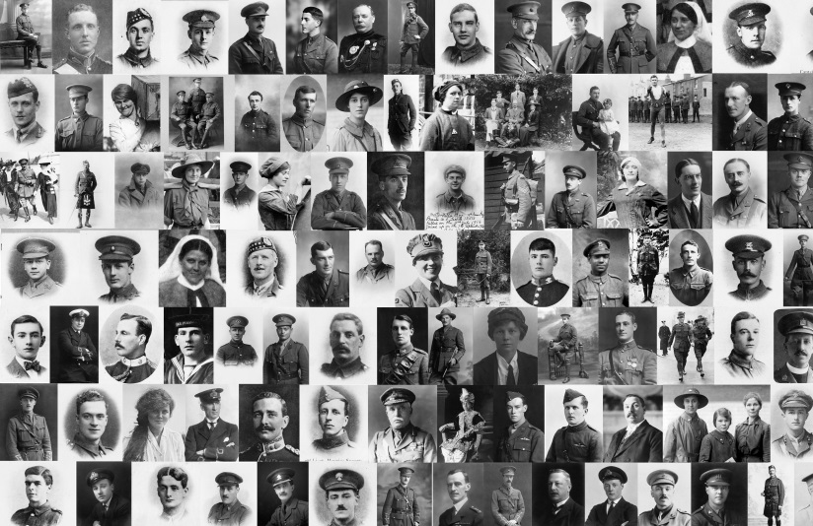
Now in the digital age, IWM can build the permanent digital memorial to all the
Lives of the First World War.

Slide 11
Lives of the First World War needs your help to piece together more than 8 million Life Stories, to share them and to save them for future generations.

Slide 12
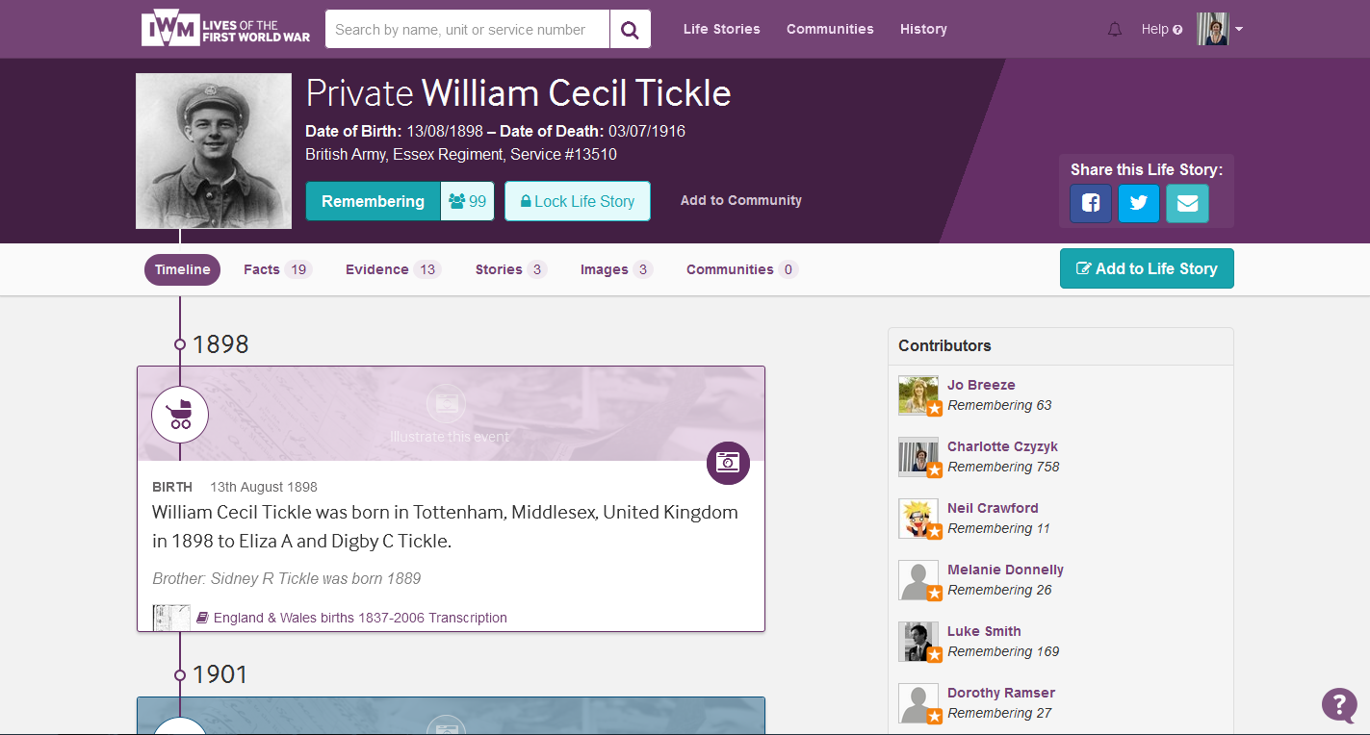
We are creating a Life Story page for every man and woman who made a contribution during the First World War, whether they died during the war or survived the conflict.

Slide 13
Whose Life Story will you discover? Find your own family members, or people who share your surname Find people listed on local war memorials Choose a name from the site to research

Slide 14
Discover their stories…
Remember their lives
livesofthefirstworldwar.org
In partnership with DC Thompson Family History

